Slide 1
Salvo Community Soccer
Central – Inver Grove Heights / Mendota Heights
East – Woodbury (Surrounding Community)
South – Rosemount / Farmington

Slide 2
Salvo Soccer Club Community Soccer provides an opportunity to play organized soccer at the Grassroots level for players aged 5-18 years old. We offer player centered programs that focus on the development of the whole player within a team environment. Salvo Soccer Club is dedicated to delivering a curriculum that allows growth to all of our players, coaches and referees.

Slide 3
Salvo Community Soccer is devoted to the enjoyment and development of our Grassroots players. The goal of our Community recreational soccer is to provide an opportunity for our community members to have fun, learn about soccer and develop a love for the game.

Slide 4
Spring Community Season (Central, East, South)
Summer Community Season (East)
Fall Community Season (Central, East, South)
Indoor Community Season (Central, East, South)

Slide 5
US Youth Soccer Region II 5-Star Recognition Award
The US Youth Soccer Region II 5-Star Recognition is awarded to a US Youth Soccer member recreational program that promotes coaching education, referee development, goal safety, kid safety, and positive sideline behavior.
Salvo is the ONLY club in the Minnesota to receive the award and the ONLY club in the Midwest to receive it twice.

Slide 6
Coach Support
Salvo Soccer Club provides weekly training session plans that are based on U.S. Soccer Grassroots best practices. Salvo provides ongoing coach education throughout the year to all of our Community Recreational coaches.

Slide 7
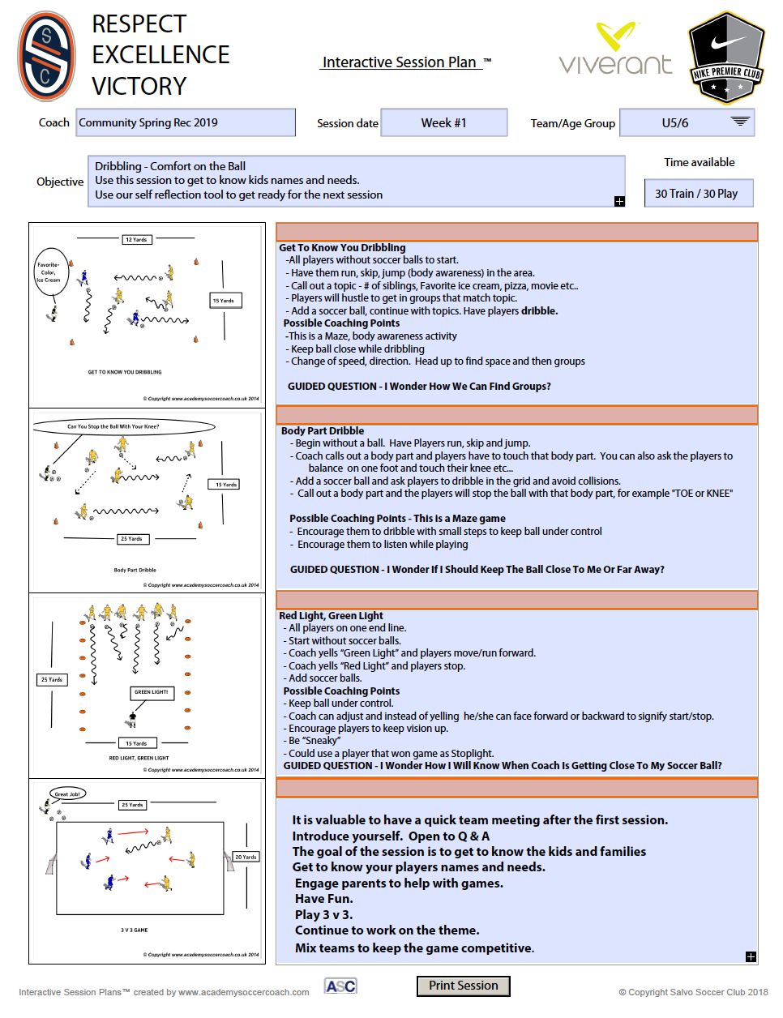
Weekly Plan
Age specific
Developmentally Appropriate
Player centered focus
Guided questions included
Clear Objectives provided

Slide 8
Club Support
Soccer curriculum based on age and length of season
Weekly practice plans in multiple forms
Player safety
Coach education
Game day tips
Referee development
Parent sideline behavior education

Slide 9
Sean McKuras
Grassroots Director
Sole focus at Salvos Soccer Club is Grassroots Programming
20+ years youth soccer club leadership experience
18 years college head coach
U.S. Soccer Grassroots Instructor License
U.S. Soccer National B License
National Youth License
MYSA / TCSL Coach education staff
State / Regional Recreation Soccer Committee Member

