Slide 1
Week 3
U5/U6
Comfort On The Ball

Slide 2
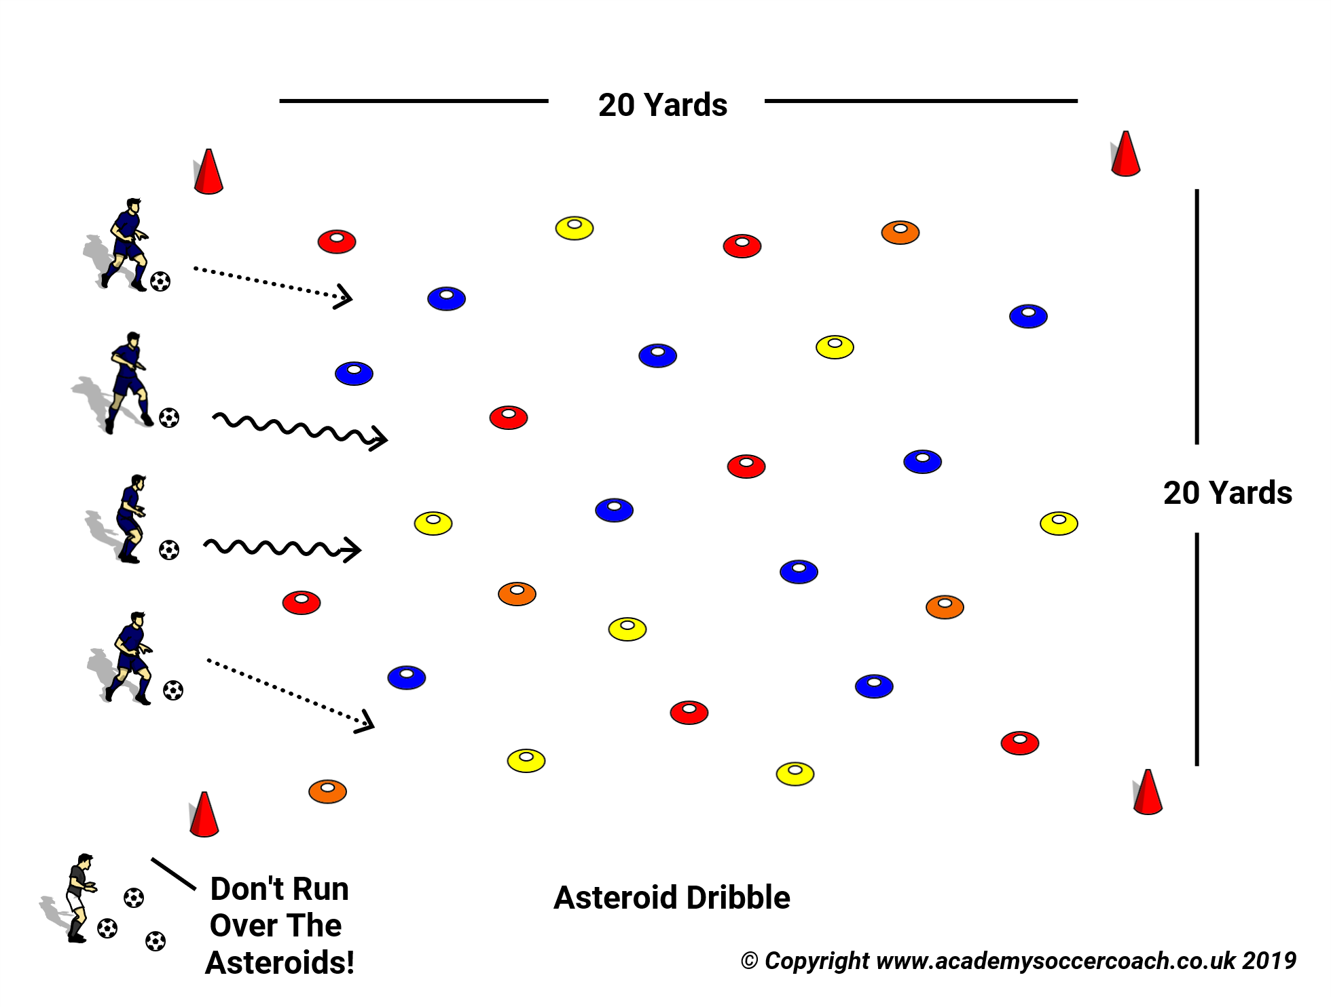
Dribbling – Asteroid Dribble
Grid 20 x 20 Yards
Start without soccer balls
Lay down cones in the grid.
Players need to get to the other side without touching any cones
Add soccer balls, if they hit an “Asteroid” they need to make a crash sound and keep going
Possible Coaching Points
Avoid hitting other players
Avoid hitting “Asteroids”
Use both feet if you can
Guided Question - How Do I Know Where To Go Next To Make Sure I Don’t Hit An Asteroid?

Slide 3
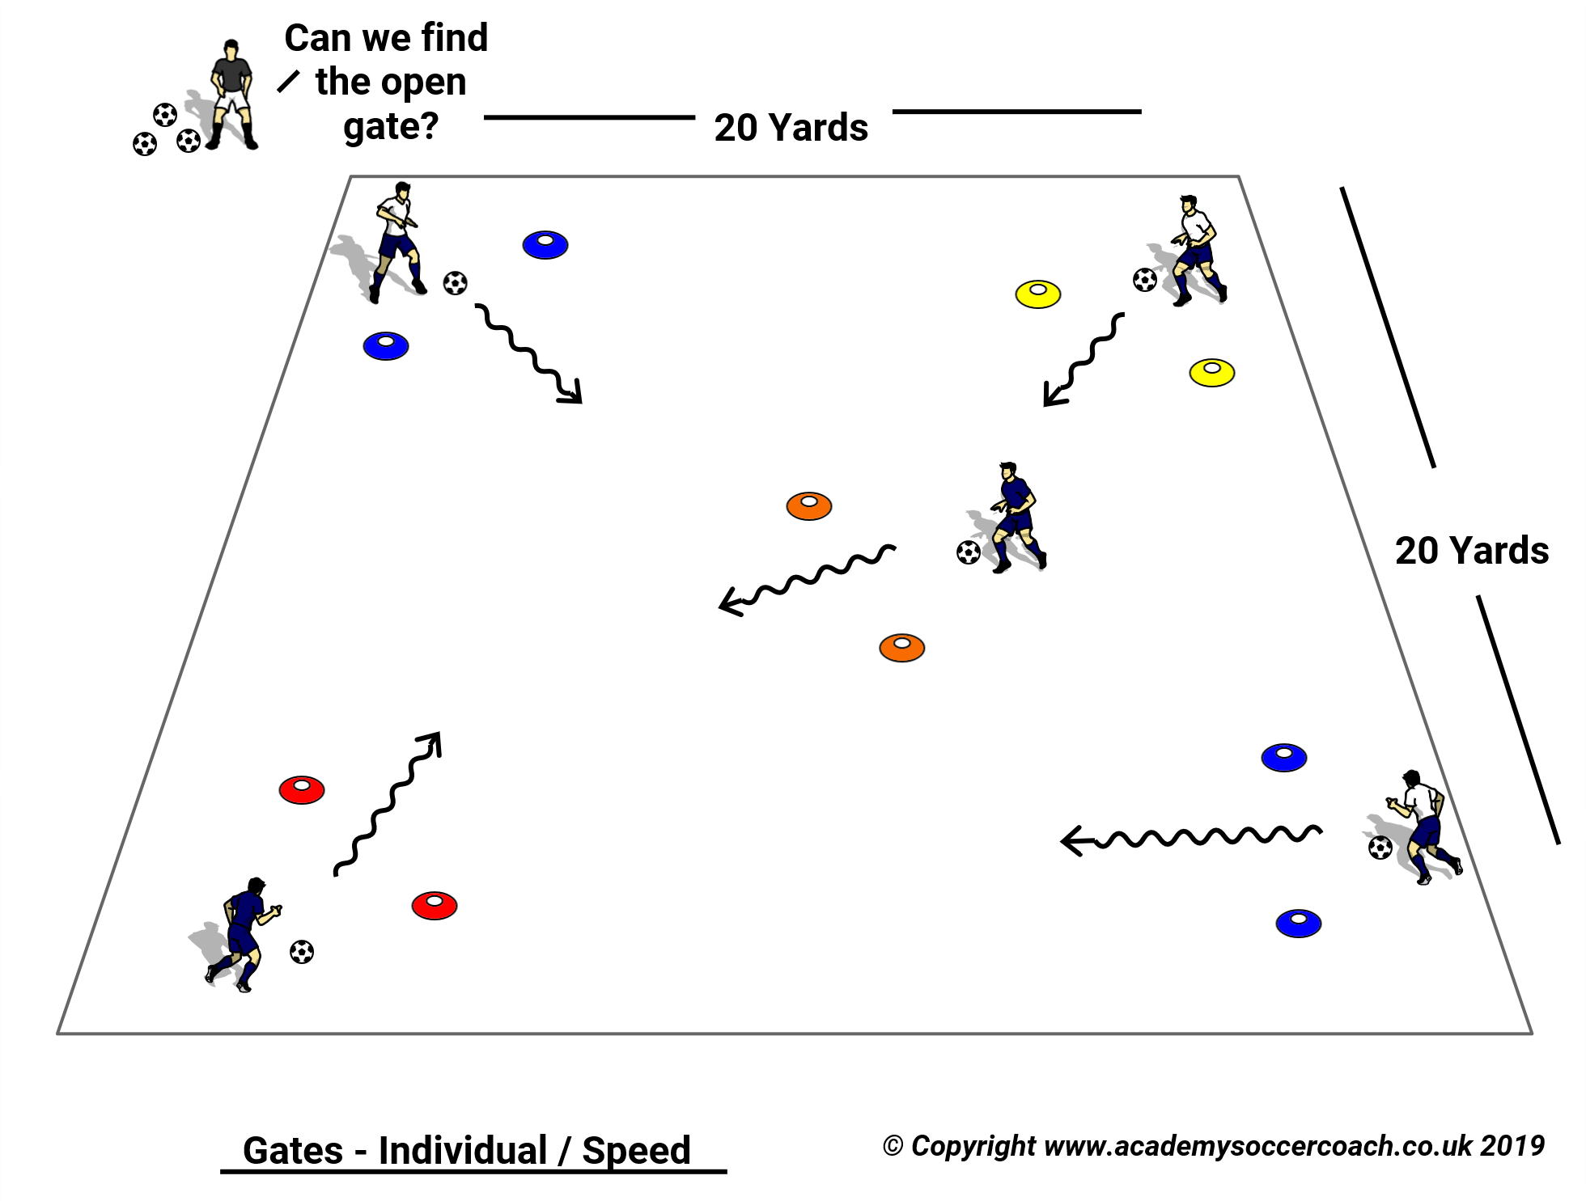
Dribbling – Individual Gates
Grid 20 x 20 Yards
Begin without soccer balls and encourage players to go through gates in different ways (run, jump, backwards)
Add soccer balls
Play short rounds. Have players yell out the number of gates they dribbled through. Then try to beat that number
Progress to doing a move through a gate. (Pull back, step over etc..)
Possible Coaching Points
Use all part of the feet to maintain control of the ball
Vision – Where is the open gate?
Be creative with surfaces of foot
Guided Question – I Wonder How I Can Get Through More Gates Next Time?

Slide 4
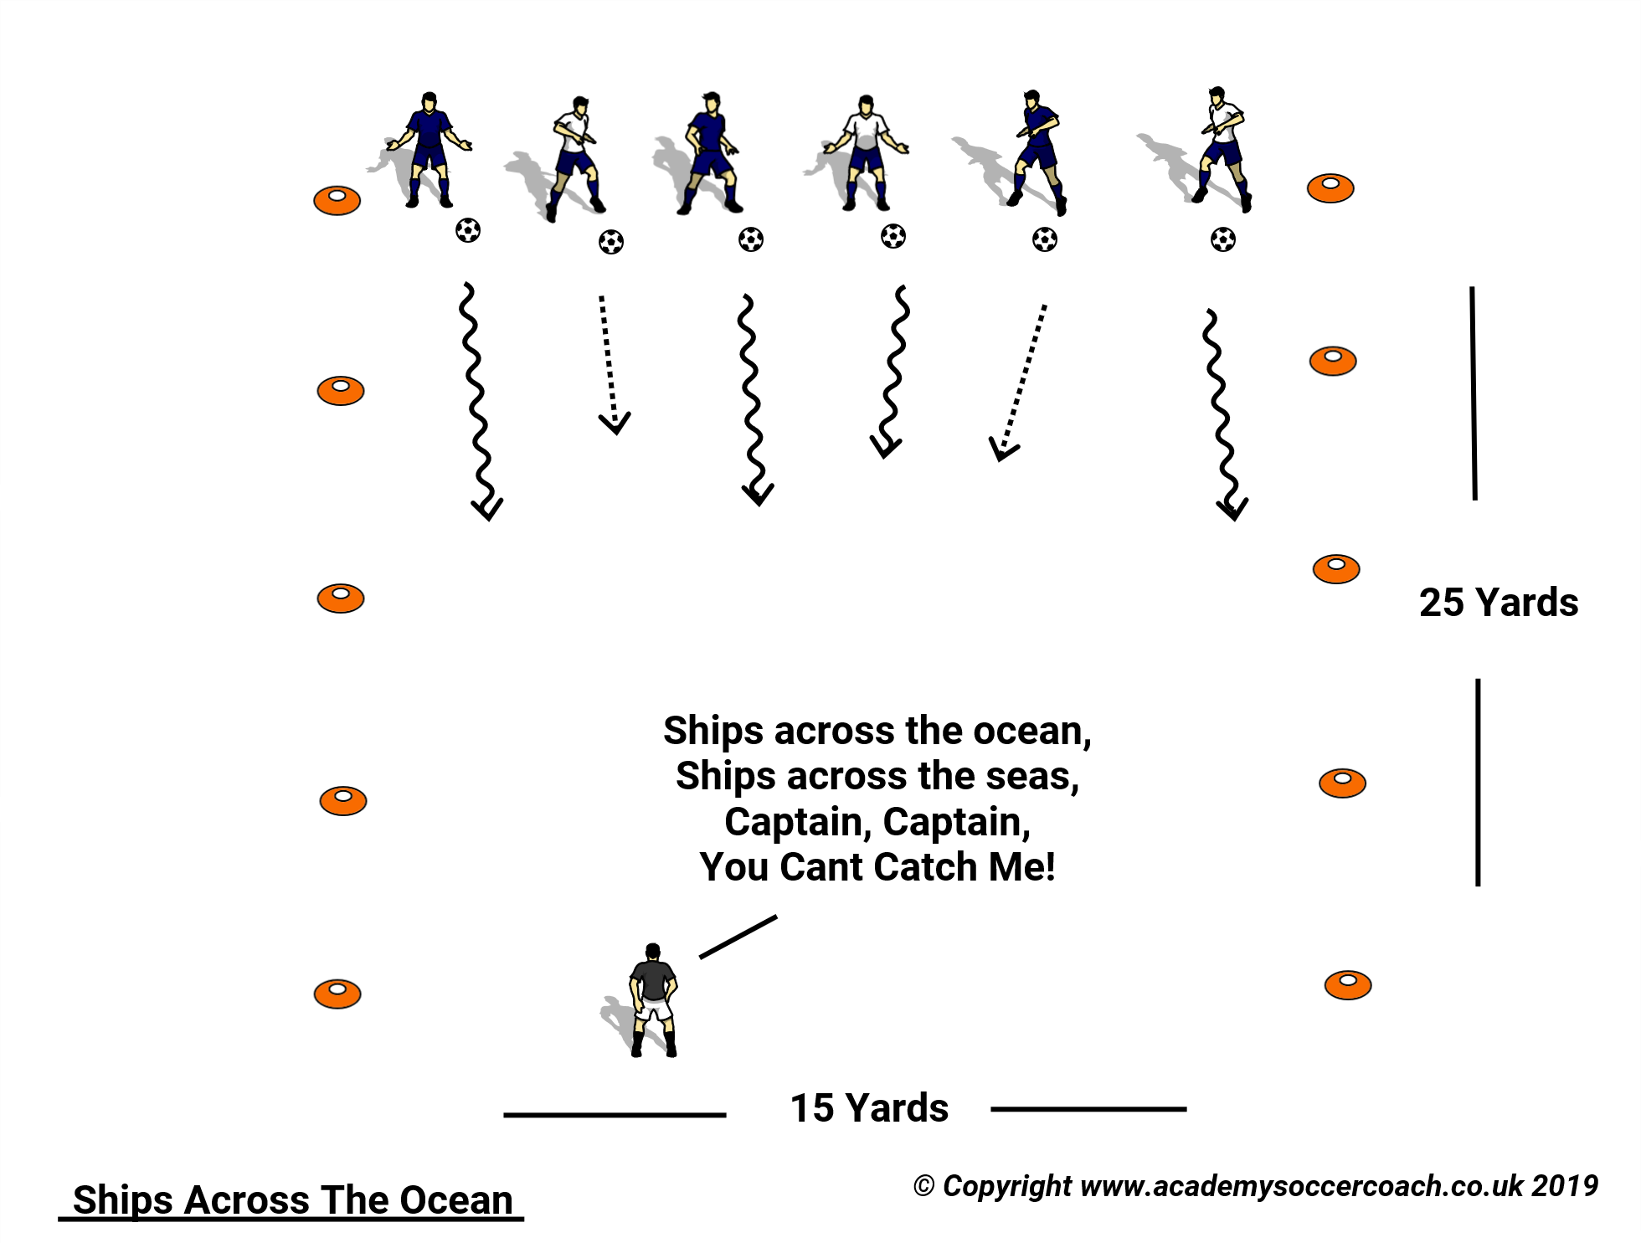
Dribbling – Ships Across The Ocean
Grid 15 x 25 yards
All players on end line without ball.
Coach in the middle.
Players sing “Ships across the Ocean, Ships across the Sea. Captain, Captain You Can’t Catch ME!!!
Players run to the far end line.
If player is tagged join the coach.
Add soccer balls. Look to put foot on the ball to tag player.
Possible Coaching Points
This is a Target game
Encourage change of direction and speed
Keep the ball close
Keep balance
Vision up and around the field
Guided Question – I wonder how you can tell where the Captain is?
Can anyone show me how to change direction?

Slide 5
3 v 3 Game Play – Practice - Play
Salvo Soccer Club utilizes the Play – Practice – Play model that is supported by U.S. Soccer.
U5/U6 Practice Model
5-10 minutes of Scrimmage to start
20+ minutes of activities
30 minutes Scrimmage with another team
Keep games to 3v3 to maximize opportunities on the ball for players.
Split your team with the other coach and run side by side games.
Rotate players to keep games competitive.

Slide 6
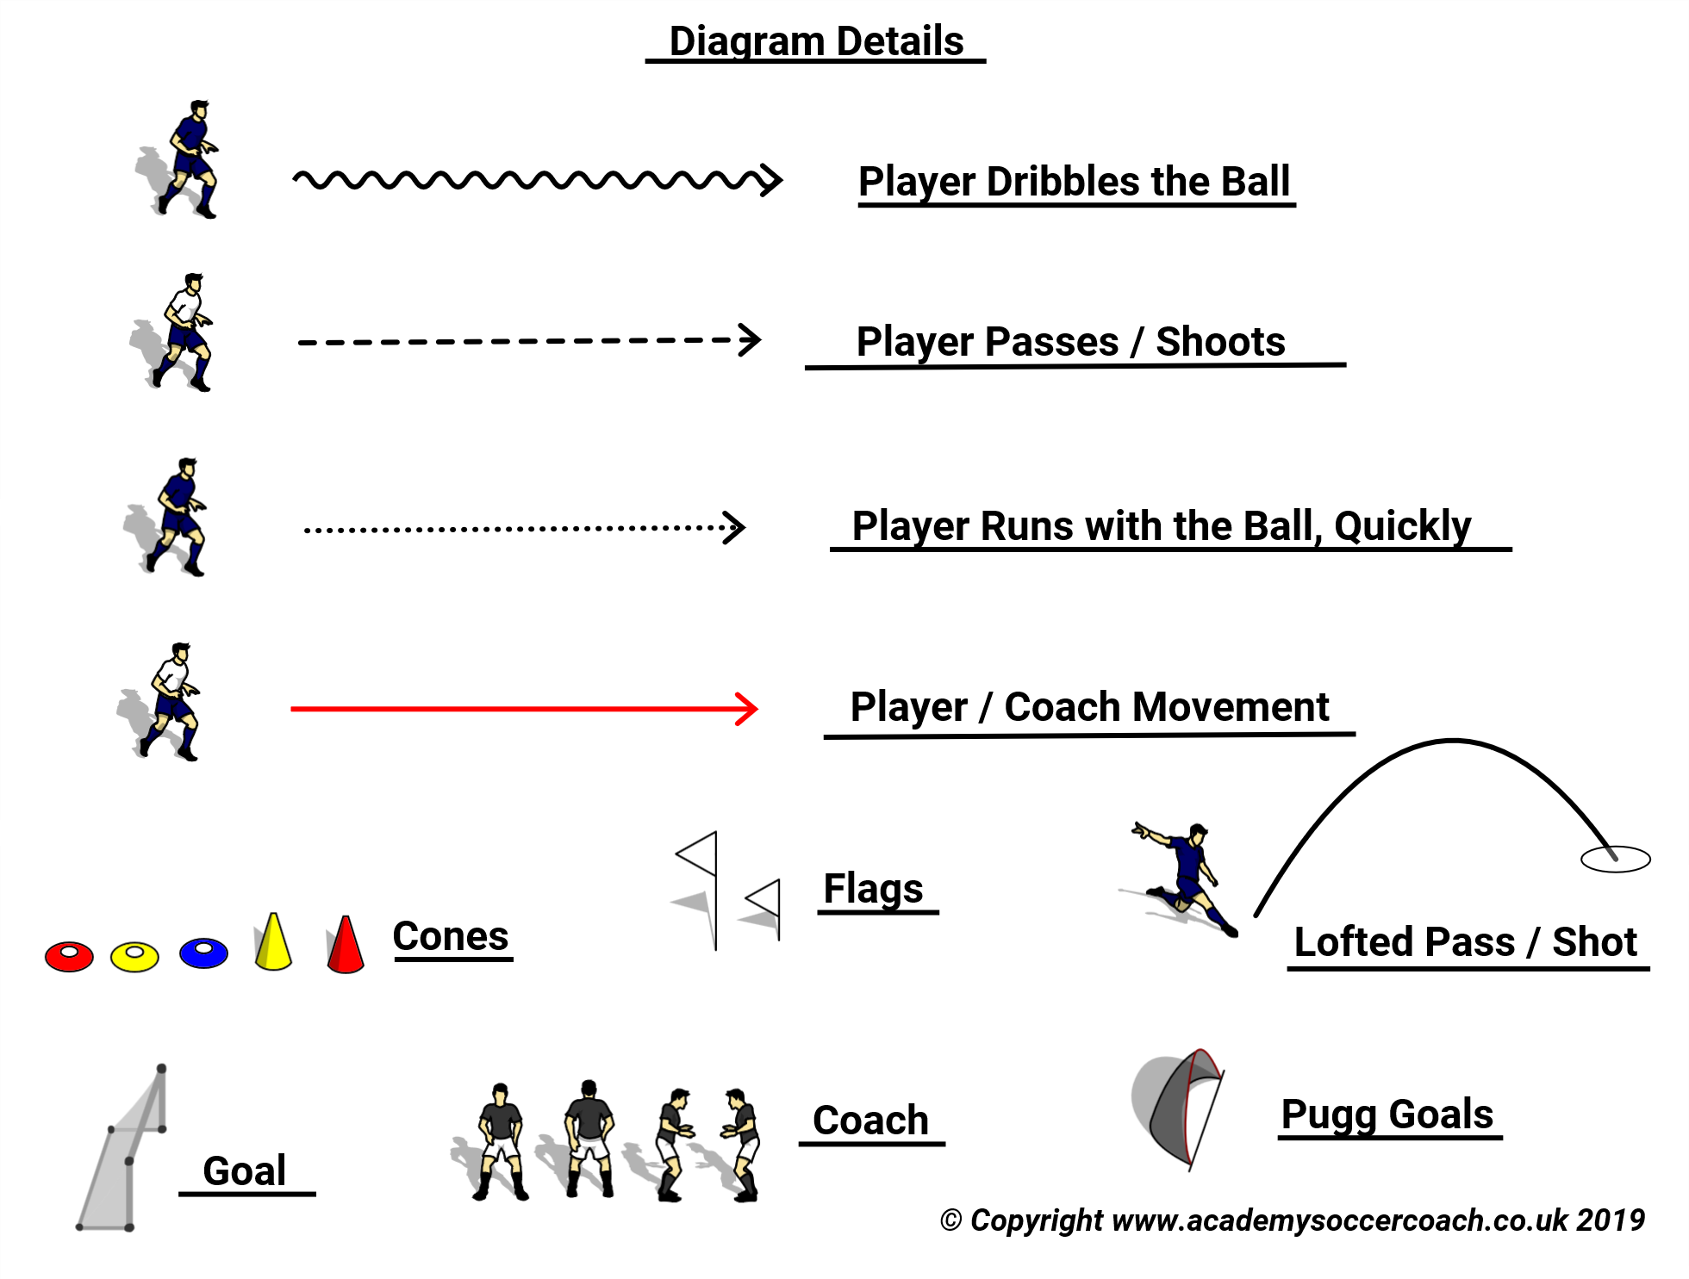
Diagram Details

